Slide 1

Microsoft
Deven Meredith, Kelvin Lu, Kai Hoyer & Bennett Kamps

Slide 2
General Information

Slide 3
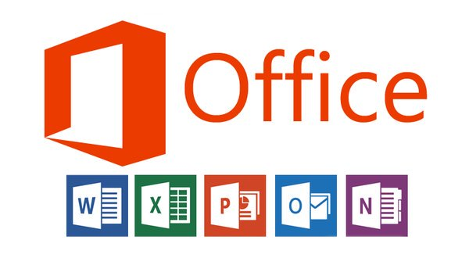
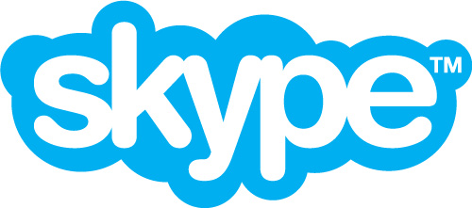
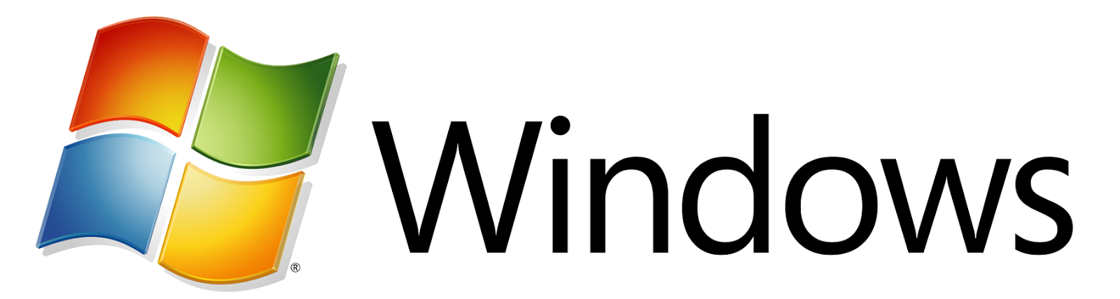
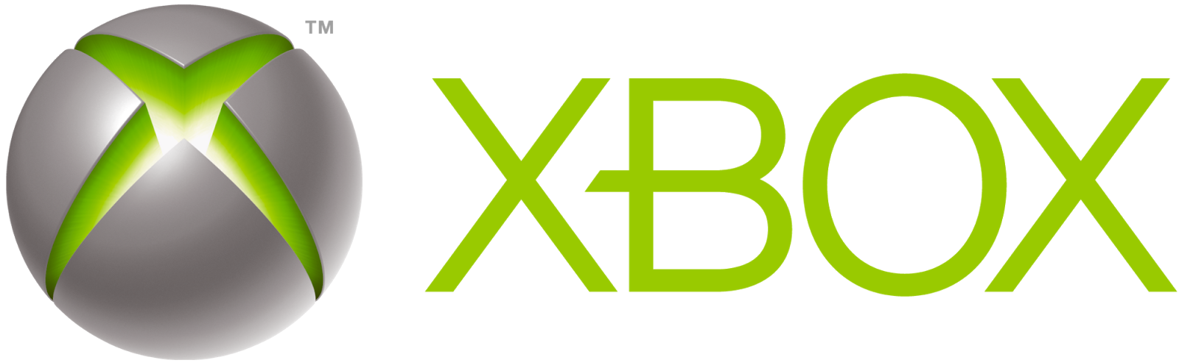
Understanding Microsoft
Microsoft is a worldwide leader in software services and devices.
Products made for both corporate and personal consumption
Products and Services include
Microsoft Windows
Microsoft Office
Skype
LinkedIn
Bing
Xbox
Nokia

Slide 4
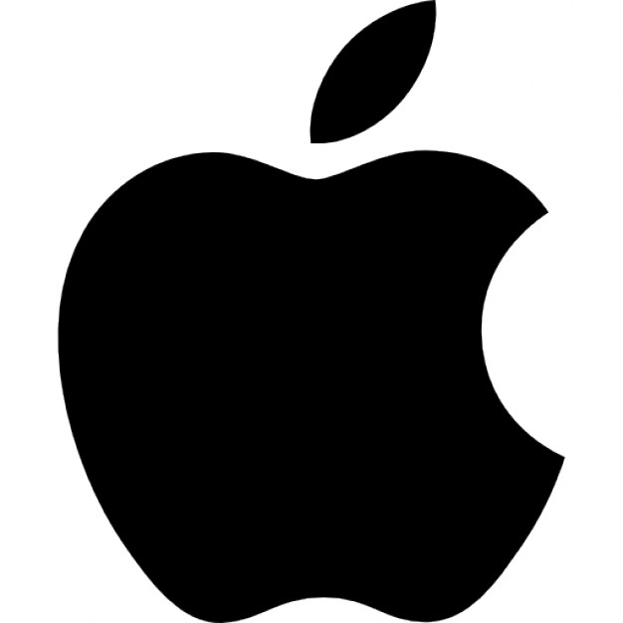

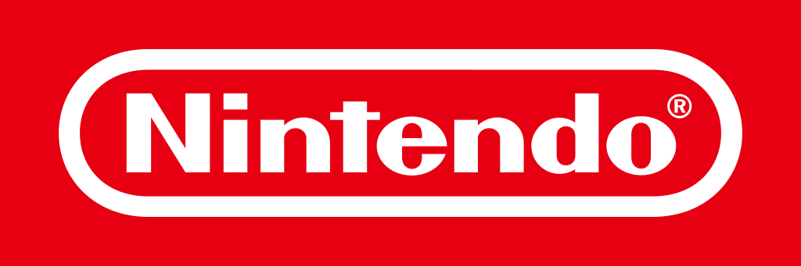



Competition
Faces stiff competition in several key areas of the technology sector
Software and Operating Systems
Apple
Google
IBM
Oracle
Hardware
Logitech
Nintendo
Sony (Playstation)
Search Engine
Google

Slide 5
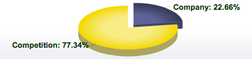
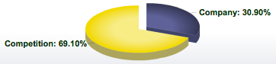
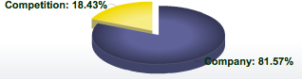
Market Share
Three segment financial reporting system since 2016
Productivity and Business Processes
Includes Office, Office 365 services, and related products.
Intelligent Cloud
Includes enterprise software and cloud-based services like Azure
More Personal Computing
Includes Windows operating systems, Xbox, devices like the Surface tablet, and online services like search.

Slide 6
Challenges and Competitive Advantages
Challenges
Marketing
Consumer experience lacking compared to competitors
Reaching individual consumers
Rebranding
AI and SaaS
Relatively new technological industry
Fierce competition from many technology firms
Competitive Advantages
Nearly 90% of all desktops use windows operating systems
Brand Recognition
Large market share of all operating financial segments
Leader in business process cloud services

Slide 7

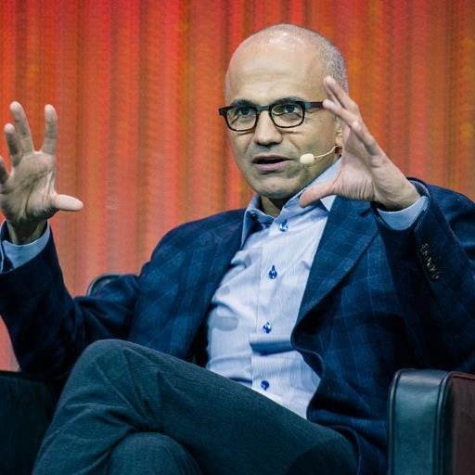
Stockholder Breakdown: Insiders
Insiders
7.3 Billion Total Shares
1.38% of shares are held by all insiders
Largest amount held by Bill Gates
166,992,934
Second largest held by current CEO, Satya Nadella
1,120,377

Slide 8



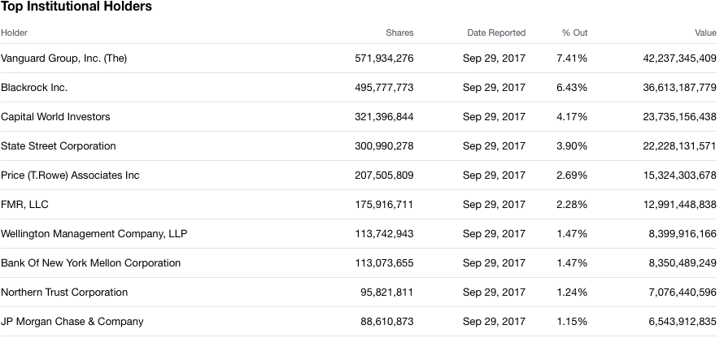
Stockholder Breakdown: Institutions
Institutional Holdings
Account for Ownership of 75.5% of total shares

Slide 9
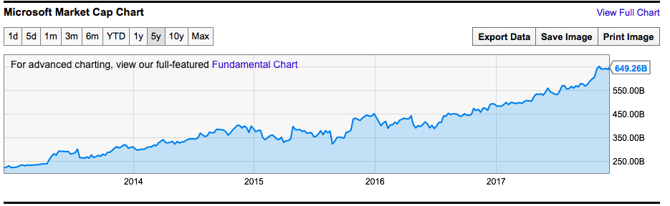
Revenue, Profit and Market Capitalization
Revenue:
89.95 billion USD
Profit:
$25.9 billion USD
Market Cap:
649.26 billion USD

Slide 10
Capital Structure

Slide 11
As of Q1 2016, Microsoft had $5.5 billion in short term debt, and $40.9 billion in long term debt.
At the same time, Microsoft had a debt-equity ratio of .62 ($74 billion in shareholder equity)
Apple, had a debt-equity ratio of .61 in the same quarter, ($130 billion in total shareholder equity)
Optimal debt ratios vary by industry but as long as it is under 2, it is considered a healthy debt to equity ratio.
Debt ratio has increased slightly from 2016 to 2017 through the issuing of new debt.

Slide 12
Debt Structure Comparison
Notes:
We can see here that Apple has more of both types of debt, with the composition between long and short term being roughly the same.

Slide 13
Using Debt: Pros and Cons
Fund projects in advance
Grow business aggressively
Retain control of company
Pay interest on loan or bond
Assets may be repossessed by bank if unable to pay interest
Borrowing against future earnings
Overreliance leads to stifled future cash flow and growth
Notes:
There are pros and cons to using debt to finance your company. Some pros include that you can fund your projects in advance, you can grow the business in an aggressive manner, and you can retain control of the company versus equity financing where you give up a portion of your power. Some cons include paying interest on the bond or loan, assets may be repossessed by the bank if you’re unable to pay the interest, you’re effectively borrowing against future earnings, and an overreliance on debt can lead to stifled future cash flow and growth.

Slide 14
Microsoft Debt Ratios
Notes:
Here we see the historical data for Microsoft’s key figures pertaining to capital structure, the debt-equity ratio, the debt-capital ratio, and interest coverage. As you can see there is a steady upward trend in the debt-equity ratio, from 2013 to today and the reason for this is that they are expanding into emerging industries such as augmented reality and artificial intelligence.

Slide 15
Payout Policy

Slide 16
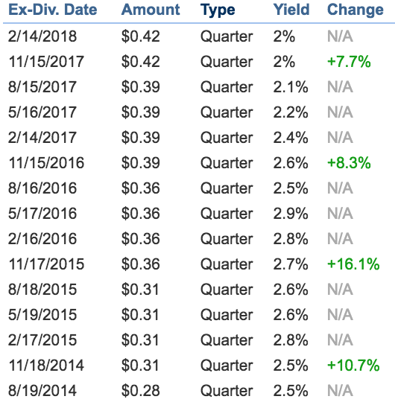
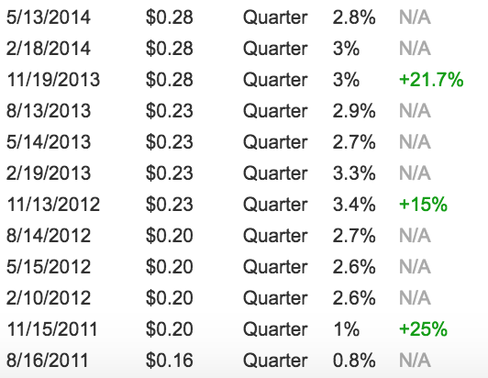
Microsoft Dividend History

Slide 17
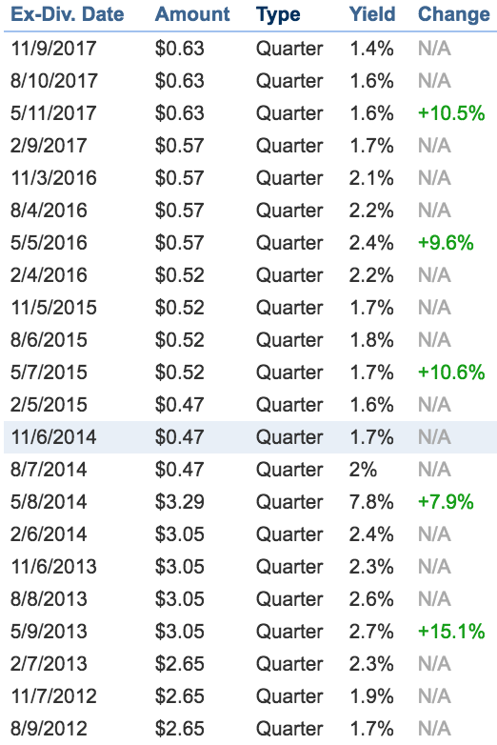

Apple Dividend History

Slide 18
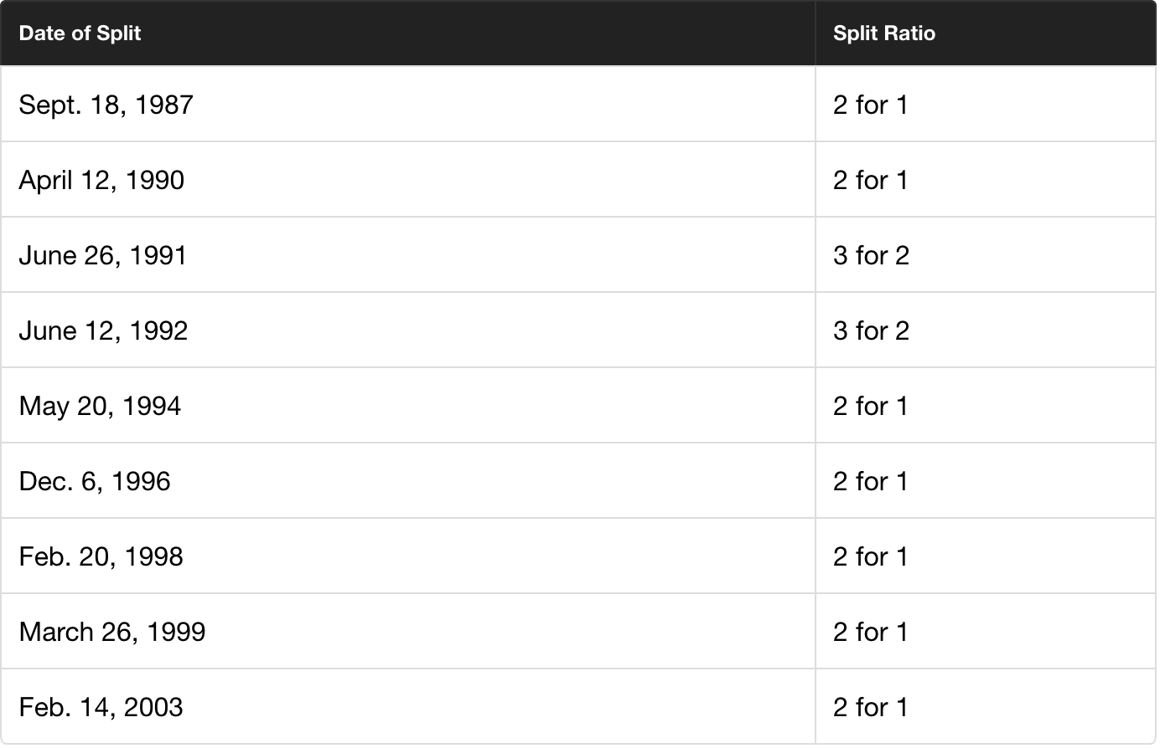
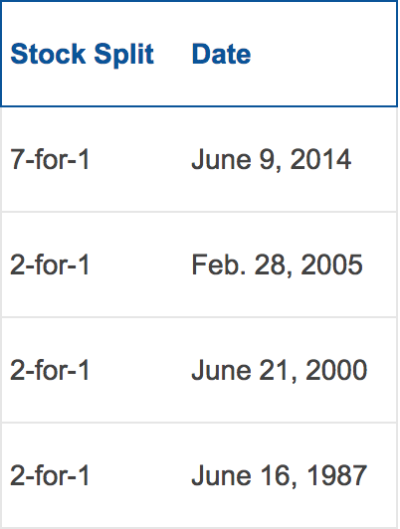
Stock Splits
Microsoft | Apple
Notes:
-Gives shareholders more shares of stock, increases the number of outstanding shares.
-Returns stock price to a “more desireable” trading range

Slide 19
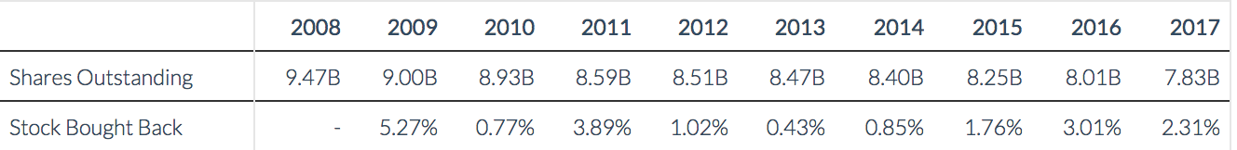
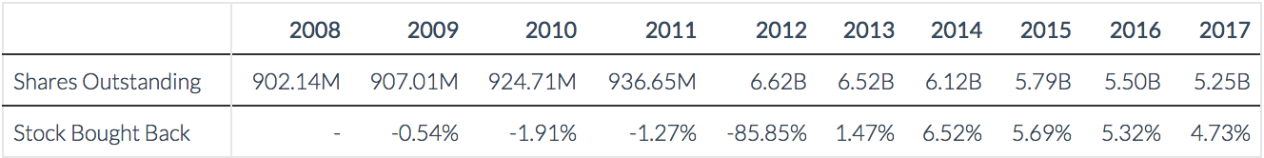
Shares Repurchased
Microsoft
Apple
Notes:
-If managers believe the price is undervalued they may repurchase stocks, causing others to also purchase the stock increasing the stock price.
- Microsoft has issued special dividends: in 2004 the company issued a one-time $3-per-share special dividend
Had $43B in Net cash and was becoming a mature company
-With so much cash overseas and the government trying to impose taxes on this foreign money, both companies may be exploring special dividends to their investors to keep from paying excess taxes on their cash.

Slide 20
Cumulated Cash Returned to Investors
Microsoft
Since 2008 Microsoft has returned $73.72B.($55.47B since 2012) Apple
Since 2012 Apple has returned $63.3B.

Slide 21
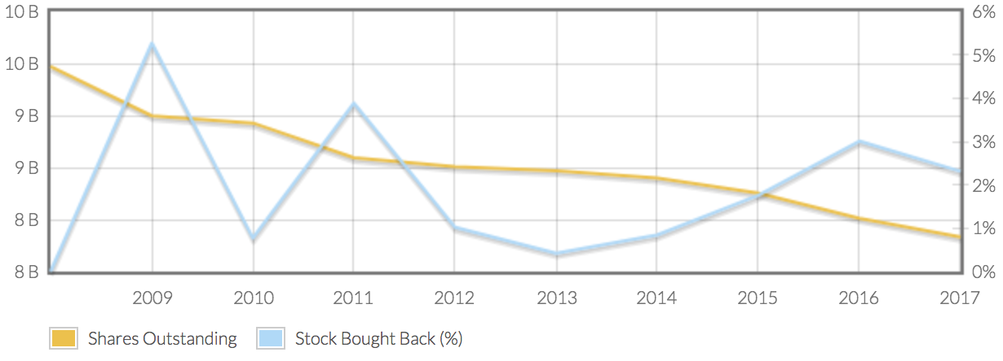
Microsoft

Slide 22
Risk & Returns

Slide 23
Sources of Risk
Competition: Microsoft faces many competitors, and barriers to entry are small
Open source software that “mimics” Microsoft products has an adverse affect on revenues
Changes in consumer tastes
Namely, shift towards tablets
Intellectual Property
Claims of infringement from third parties
Piracy of Microsoft products
Particularly a concern in countries with weak anti-piracy laws
Security Concerns: Vulnerabilities in Microsoft Products could lead to reduce usage as well as liability claims
Additionally, there is the risk of unauthorized disclosure of Microsoft’s source code

Slide 24
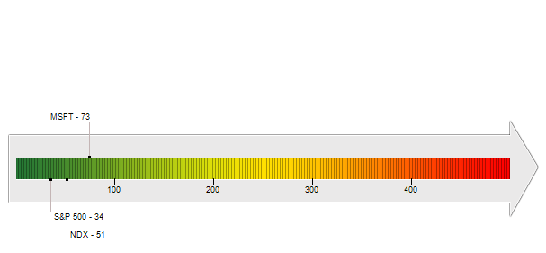
Risk Assessment of Microsoft
As of 12/8/17, Microsoft has a risk grade of 73
RiskGrade is based on historical market volatility- similar to standard deviation
The lower the score, the less risky the stock and a company with a score less than 100 is considered low risk.
Microsoft has a lower risk grade than many of their competitors

Slide 25
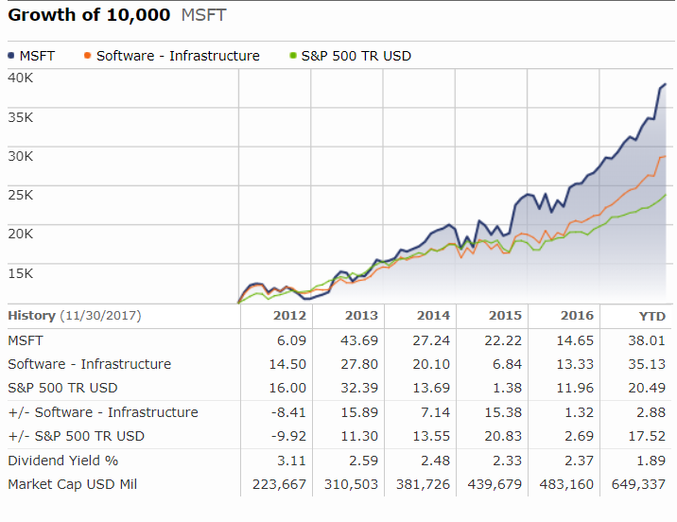
Beta & Expected Returns
Firm Beta: 1.49
Microsoft stock is more volatile than the market
More volatile than competitors
Apple: 1.34
IBM: 1.07
Oracle: 1.05
Computer Services industry beta: .99
Expected Rate of Return using the CAPM: 13.73

Slide 26
Investments

Slide 27
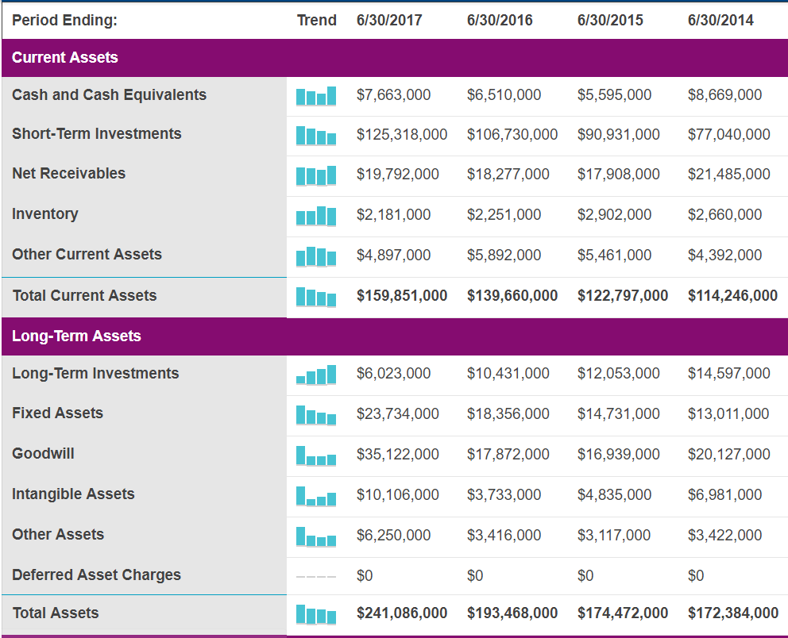

Slide 28
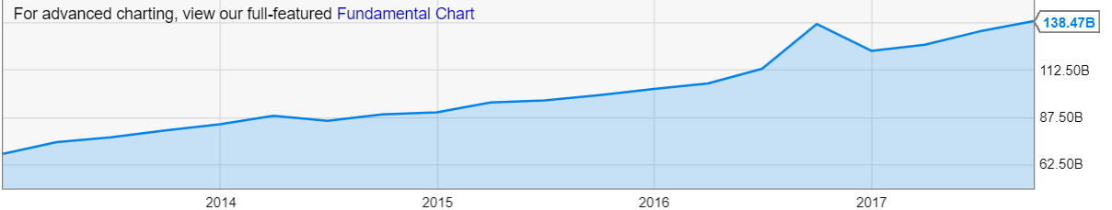
Short Term Investments

Slide 29
Short Term Investments (cont.)
Currently Microsoft has short term investments totalling $138.47 billion
This is a considerable amount
For comparison, Apple has $74.2 billion worth of short term investments
From their annual report- “Our short-term investments are primarily to facilitate liquidity and for capital preservation. They consist predominantly of highly liquid investment-grade fixed-income securities, diversified among industries and individual issuers. The investments are predominantly U.S. dollar-denominated securities, but also include foreign currency-denominated securities in order to diversify risk."

Slide 30
Long Term Investments
As of September 2017, Microsoft has $6.02 billion worth of long term investments
These investments are focused around creating new products and updating existing ones
Cloud Computing
Office 365 and Azure
Cell Phones
Mixed success in this area so far
Artificial Intelligence
Microsoft has made 18 acquisitions in this area over the past few years
Cybersecurity
Currently investing over one billion a year

Slide 31
Questions?

